Slide 1

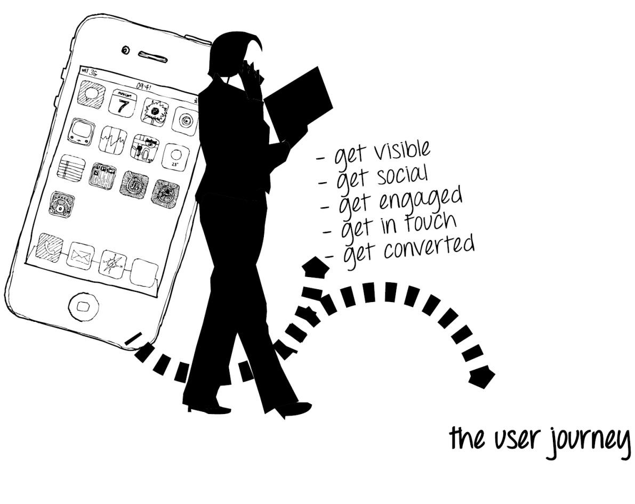
API changes EPiServer 7 - CMS6R2
Upgrade from CMS6R2

Slide 2
Requirements
.NET Framework 4
MVC 4
IIS7
Upgrade
Through DeploymentCenter.
Requires recompilation after upgrade.

Slide 3
API changes
CMS now supports other types of content than pages (PageData instances)
Many methods that previously handled PageData and PageReference have been replaced with methods that handles IContent and ContentReference.
Events on DataFactory (e.g. LoadedPage, PublishedPage) has been increased with content events (e.g. LoadedContent, PublishedContent). Exposed by DataFactory/IContentEvents.
StartPage is no longer 3 for new sites (3 will be GlobalBlockFolder).

Slide 4
New edit mode
Custom properties will be edited in a modal dialog that wraps WebForms controls. Can be converted to a DOJO widget.
Old edit mode still exist and can be activated through a config setting.
When rendering PropertyData without use of Property WebControl there is a possibility to use EditHints to get on page edit support of the properties.

Slide 5
Relocations/Consolidations
VirtualPathProvider registration have been moved to EPiServer.Framework and hence has the configuration moved to EPiServerFramework.config.
IEntity, IEntityProvider etc. have been moved from EPiServer.Common to EPiServer.Data.
Localization support moved to EPiServer.Framework

Slide 6
Typed Pages
Possible to run PageTypeBuilder in parallel.
Conversion from PageTypeBuilder is normally to replace attributes (some parts like default values are set by overriding methods instead). There is however no support to convert from Property Groups to blocks.
Simple tool to create c# class from an untyped page type. Will be distributed by blog post or similar.

Slide 7
MVC
Possible to run MVC and WebForm in parallel. It is for example possible to have both a MVC renderer and a WebForm renderer for the same type (for example a block). The renderer to use will be decided depending on the context.
Routing – FriendlyUrlRewrite providers. Incoming requests will be routed through RouteTable which has the consequence that incoming event from FriendlyUrlRewrite will not be raised. Outgoing URLs can be modified by events on EPiServer.Web.Routing.PageRoute (alternatively a custom Route implementation). Incoming URLs can be modified by custom Route implementation registered before EPiServer routes.

Slide 8
Builtin CMS search
CMS now uses EPiServer.Search (lucene based) as default search implementation (same as in Relate).
At upgrade new indexes will be created automatically at first initialization of the site.
Does not affect FindPagesWithCriteria. It is used for free text search.

Slide 9
Breaking changes
IDynamicContent has changed so parameter PageBase have been replaced by IContentBasePage (to support dynamic content on Blocks).
GetPageDirectory and GetPageLanguage have been removed from PageData and been replaced by extension methods for PageData in EPiServer.Core namespace.

Slide 10
Obsolete marked
Static methods like Load, List on e.g. PageType, LanguageBranch. Have been replace by methods on corresponding repository (e.g. IContentTypeRepository, ILanguageBranchRepository).
LanguageManager class. Been replace by LocalizationService (have a static property Current).
GlobalPageValidation have been replaced by ValidationService in EPiServer.Framework. Custom implementations possible by IValidate<T>.
PageDefinition have been replaced by PropertyDefinition.
Certain methods on DataFactory that was page specific, e.g. GetParents, GetSettingsFromPage and GetPageProvider.

Slide 11
Database changes
A number of tables have changed name. The old names are dock kept as Views. For example:
tblPage => tblContent
tblPageType => tblContentType
tblProperty => tblContentProperty
tblAccess => tblContentAccess

Slide 12
Feedback or Questions?
Forum on world.episerver.com

